Slide 1
HOUSE PRICE PREDICTION
MAT 271

Slide 2
INTRODUCTION
The goal of the project is to predict house prices in California based on features such as location, size, number of bedrooms and number of bathrooms
California house price dataset was used to creat the model

Slide 3
Did a train test using 20% of the data .
Splitted the data in x_train(data without the median house values)and Y_train (the median house values)
Jointed the x_train data with the y_train data

Slide 4
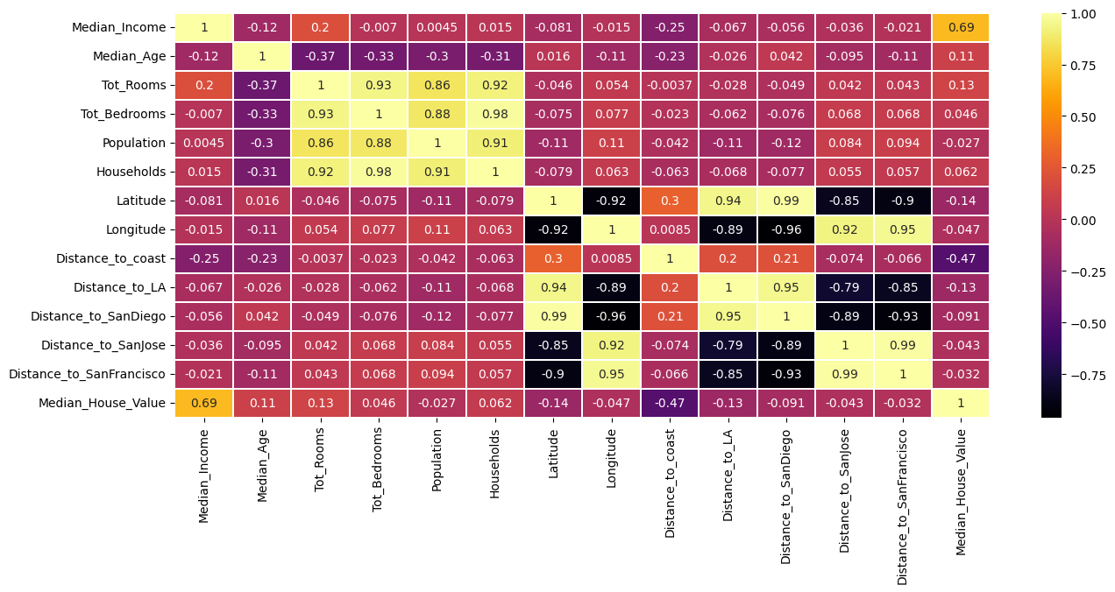

Slide 5
With the data I found out which data correlate with each other .
For example ;
the number of bedrooms highly correlate with population
total number of rooms highly correlate with number of rooms
while longitude and latitude have a negative correlation
The higher the value the was the higher the correlation

Slide 6
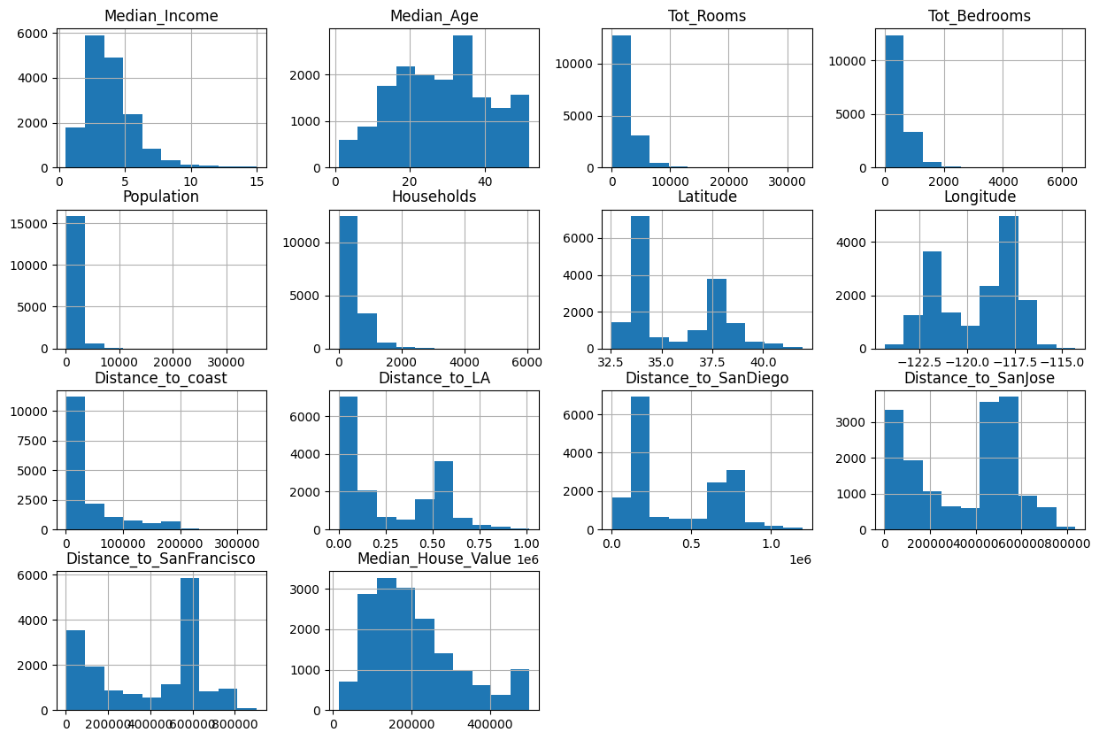

Slide 7
Median income and median house value its data skewed to the right
Median age is almost evenly distributed with most people between 20 and 40
The number of rooms, bedroom, population, household, distance to coast the frequency decreases with their increase.

Slide 8
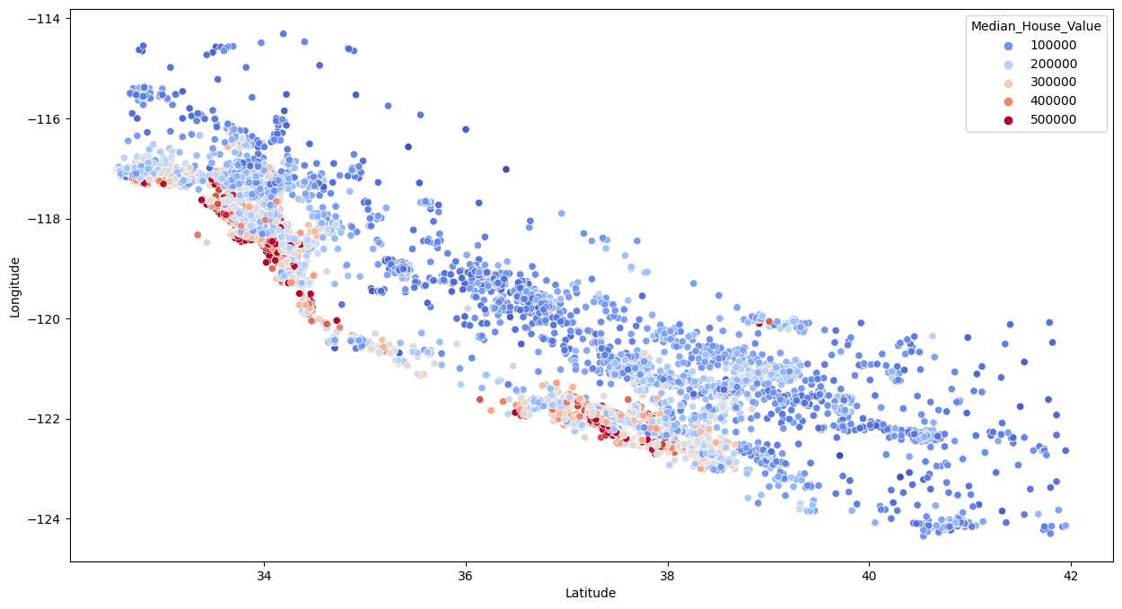

Slide 9
The expensive houses are red which decreases with the change in color as shown
The most expensive houses are along the coast

Slide 10
Output
The data was 83% accurate
rf.score(X_test,Y_test)
0.8317751745281
.rf.predict([[8.3252,41,880,129,322,126,37.8,-122.23,9263.04077285038,556529.1583418,735501.80698384,67432.5170008434,21250.2137667799]])
array([464696.47]) -output

